Slide 1
Radio Merit Badge
Presented by: Shane McCracken
Troop 229
Independence, MO

Slide 2
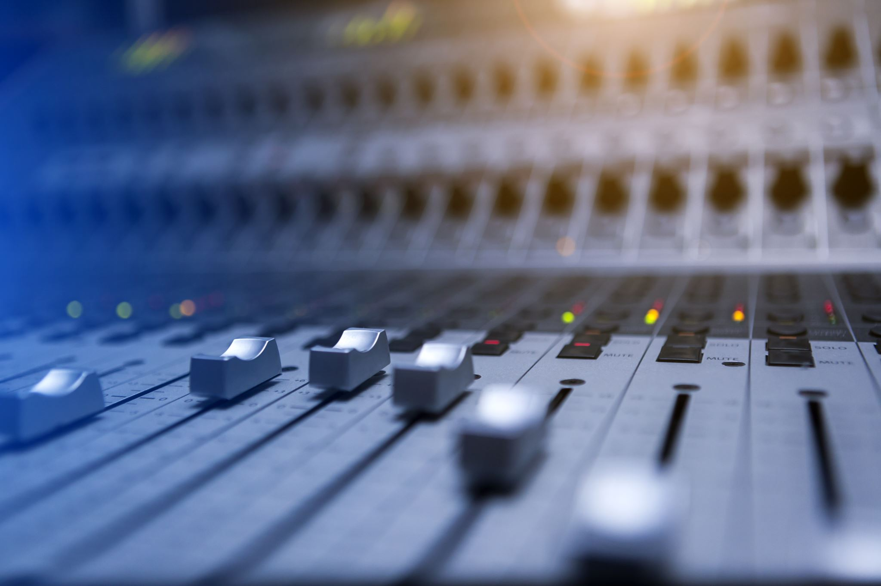
Requirement: 1
Explain what radio is. Then discuss the following:
a. The differences between broadcast radio and hobby radio.
b. The differences between broadcasting and two-way communications.
c. Radio station call signs and how they are used in broadcast radio and amateur radio.
d. The phonetic alphabet and how it is used to communicate clearly.

Slide 3
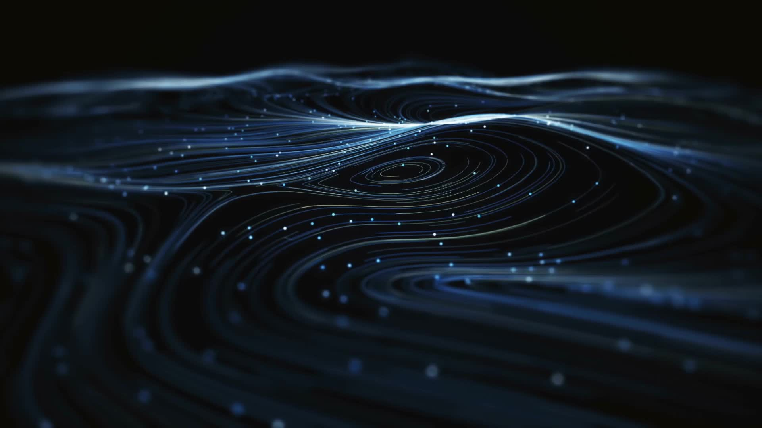
Radio is a way to electronically communicate without wires
Radio sends information from one location to another using electromagnetic waves. The information could be morse code, your voice, music, or data. Electromagnetic waves are created when we get an electrical circuit to vibrate electrons back and forth thousands or millions a time per second.
You probably already know broadcast radio, but radar, wireless networks, remote car locks, cell phones, microwave ovens, communications satellites, television, satellite navigation systems, EZ-Pass toll systems and those security tags in stores are all radio too!

Slide 4
Broadcasting
Uses radio to send information to many people at the same time. Hobby radio is the use of radio by ordinary people such as ham radio operators to communicate with each other or to control models.
Broadcasting is a one way transmission to many receivers at the same time such as a local music station or television station.

Slide 5
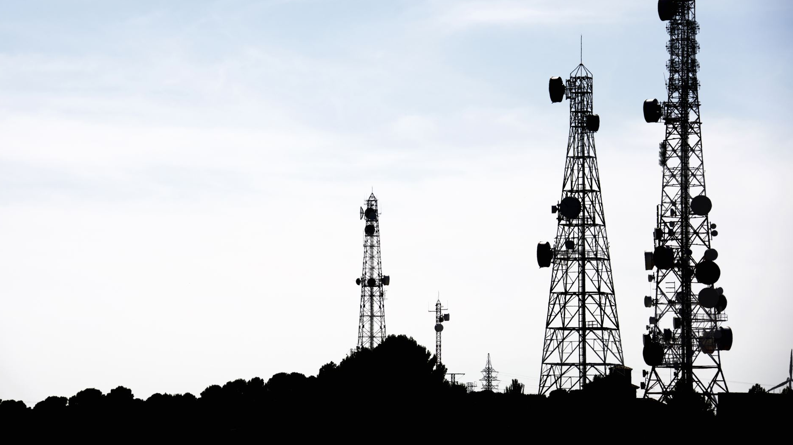
call signs
All radio transmitters must use call signs to prove that they have been licensed. Some broadcast call signs are WABC or KYW. Amateur Radio Call signs are like K2GW or KC2PNP, with a number in them.

Slide 6
Phonetic Alphabet
Because some letters such as "C" and "E" might sound alike when transmissions are noisy, standard Phonetic Alphabet words are often used to make things understood.

Slide 7
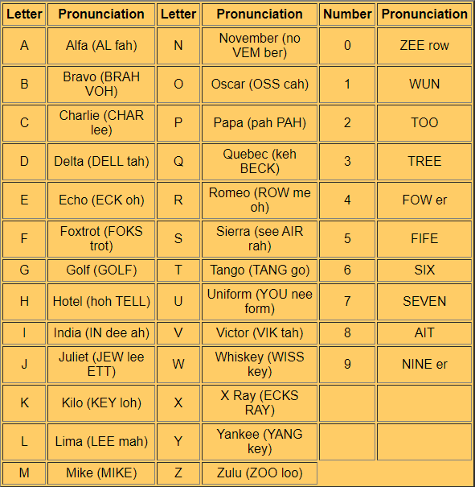
For example, you might say "My name is Shane, I spell Sierra, Hotel, Alpha, November, Echo.”

Slide 8
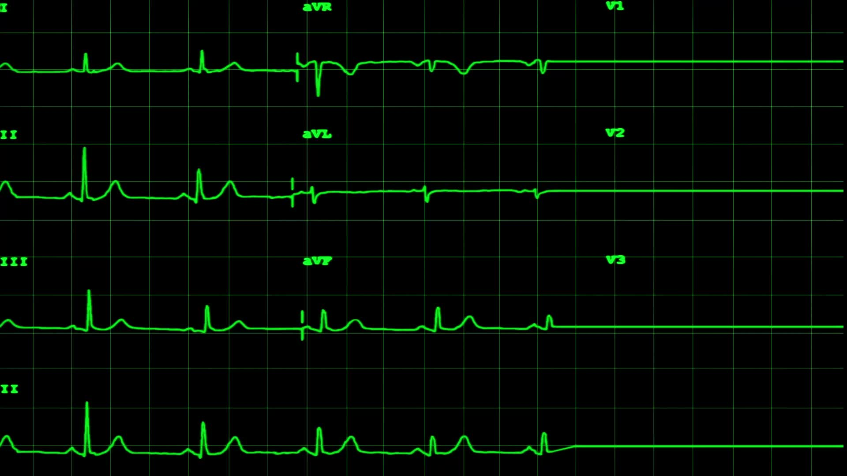
Requirement: 2
Do the following:
a. Sketch a diagram showing how radio waves travel locally and around the world.
b. Explain how the broadcast radio stations WWV and WWVH can be used to help determine what you will hear when you listen to a shortwave radio.
c. Explain the difference between a DX and a local station.
d. Discuss what the Federal Communications Commission (FCC) does and how it is different from the International Telecommunications Union.

Slide 9
way for radio waves to travel
The most common way for radio waves to travel is in a straight line of sight from one antenna to another. This is most common for radio waves using frequencies of 30 MegaHertz (30 MHz or 30 million changes of direction per second) or higher.
Radio sky waves between 3 and 30 MHz can also reflect off the electrically charged upper atmosphere, which is called the Ionosphere, to then bounce thousands of miles around the earth.
Radio Waves below 3 Mhz can hug the earth's surface to travel hundreds of miles using ground waves.

Slide 10
Radio Waves

Slide 11
WWV and WWVH
Radio station WWV is located in Fort Collins Colorado and WWVH is located in Hawaii. Both provide precise time signals and transmit exactly on the frequencies of 5, 10, 15 and 25 MHz. They also provide information on how well the Ionosphere is bouncing radio signals today.
They can be used to set your clock, to calibrate your receiver and transmitter, and to see how well radio signals can travel to and from Colorado and Hawaii.

Slide 12
Local vs DX
Signals from nearby stations are called local, while those from far away places are called "DX". "DX" is the old Morse Code abbreviation for "distance".

Slide 13
What is the FCC
The FCC is the Federal Communications Commission. It regulates and issues radio licenses in the United States. The ITU is the International Telecommunications Union and the agency of the United Nations that establishes international standards for radio.

Slide 14
Requirement: 3
Do the following:
(a) Draw a chart of the electromagnetic spectrum covering 300 kilohertz (kHz) to 3000 megahertz (MHz).
(b) Label the MF, HF, VHF, UHF, and microwave portions of the spectrum on your diagram.
(c) Locate on your chart at least eight radio services, such as AM and FM commercial broadcast, citizens band (CB), television, amateur radio (at least four amateur radio bands), and public service (police and fire).

Slide 15
Medium Frequencies
Medium Frequencies - The frequencies from 300 KHz to 3 MHz are called the Medium Frequencies. The usually follow the earth's surface using "Ground Waves" and can reach hundreds of miles. AM broadcasters are found here

Slide 16
High Frequencies
High Frequencies - The frequencies from 3 MHz to 30 MHz are called the High Frequencies or "HF" The usually bounce off the Ionospere using "Sky Waves" and can reach thousands of miles. Shortwave broadcasters and many Ham bands are found here

Slide 17
Very High Frequencies
Very High Frequencies - The frequencies from 30 MHz to 300 MHz are called the Very High Frequencies or "VHF" The usually go right through the Ionosphere and so are mostly used for line-of-sight communications on earth. They also can be used to talk to spacecraft. FM Radio and TV broadcasters as well as many Police, Fire and Aircraft radios operate here. The popular 6-meter and 2- meter Ham bands are found here.

Slide 18
Ultra High Frequencies
Ultra High Frequencies - The frequencies from 300 MHz to 3000 MHz are called the Ultra High Frequencies or "UHF" The usually go right through the Ionosphere and so are used for line-of-sight communications on earth. They also can be used to talk to spacecraft. UHF TV broadcasters as well as some Police, Fire radios and cell phones operate here. The 440 MHz Ham band is found here

Slide 19
Requirement: 4
Explain how radio waves carry information. Include in your explanation: transceiver, transmitter, receiver, amplifier, and antenna.

Slide 20
How Radio Works
Radio waves are created when an oscillator circuit gets electrons to vibrate thousands or millions of times per second. An amplifier in the transmitter makes these Radio Frequencies (RF) more powerful.
If the circuit is turned on or off in a pattern using a telegraph key, information may be sent using Morse Code.You can also talk into a microphone and have a circuit then modulate the radio waves to have them carry your voice signal.
In both cases, these radio waves are then fed to an antenna which lets them travel through space. An antenna somewhere else catches the radio waves and feeds them to a receiver where they are demodulated into Audio Frequencies (AF) and played through headphones or a speaker.
A transceiver is a radio that has both a transmitter and receiver in the same case.

Slide 21
Requirement: 5
Do the following:
(a) Explain the differences between a block diagram and a schematic diagram.
(b) Draw a block diagram for a radio station that includes a transceiver, amplifier, microphone, antenna, and feed line.
(c) Discuss how information is sent when using amplitude modulation (AM), frequency modulation (FM), continuous wave (CW) Morse Code transmission, single sideband (SSB) transmission, and digital transmission.
(d) Explain how NOAA Weather Radio (NWR) can alert you to danger.
(e) Explain how cellular telephones work. Identify their benefits and limitations in an emergency.

Slide 22
Block Diagrams
A block diagram shows the different sections of a transmitter or receiver.

Slide 23
Schematic diagram
A more detailed schematic diagram shows all of the individual electrical components used to build the radio. For more information on schematic diagrams and electronic components, you might wish to explore Electronics Merit Badge.

Slide 24
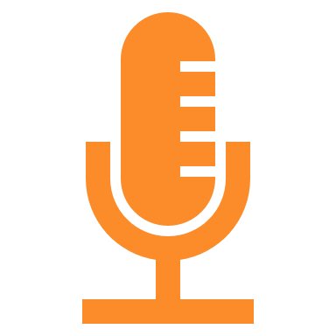
Draw a Block Diagram
Activity!
Draw a block diagram for a radio station that includes a transceiver, amplifier, microphone, antenna, and feed line.

Slide 25
how information is sent
Transmitters generate "Radio Frequency" (RF) energy. This RF energy is then modified to convey useful information. The simplest method to send information is to turn the transmitter on and off in recognizable pattern, such as Morse code. This has the advantage of being simple radios to build, and is very efficient in using both electrical power and "bandwidth". The disadvantage is the both the person transmitting and receiving the signal need to know Morse Code. Morse Code transmissions are often called "CW" for "Continuous Wave" which describes how the underlying signal is now generated.

Slide 26
Amplitude Modulation
The first technique to be developed is called "Amplitude Modulation" or AM. In this case, the strength of the RF signaled is varied by the sound of the voice being placed on it. While simple to do, this requires a bit of power, occupies a bit of bandwidth, and is subject to atmospheric noise.

Slide 27
Single Side Band
To reduce, the bandwidth and power needed on the HF bands, voice communications are often done using "Single SIde Band" (SSB), which cuts the transmission in half, and suppresses a lot of the carrier signal. The receiver then adds the carrier back using a "Beat Frequency Oscillator" (BFO) to make the "Donald Duck" sounding signal intelligible. It does require more frequency stability and some skill on the receiving operator, so this is mostly used for point-to-point communications instead of broadcasting.

Slide 28
Frequency Modulation
For a really good high fidelity sounding signal, which is especially important when transmitting music, "Frequency Modulation" (FM) is used. In this case the frequency of the carrier signal is varied by the information, instead of the amplitude. This provides a very realistic sound, but since it takes lots of power and bandwidth, is restricted to the VHF and higher portions of the spectrum.

Slide 29
Digital Transmission
A more modern techniques is digital transmission. In this case, the audio signal of a voice is sliced up, sampled, measured, and converted to a numerical value for each millisecond. This data is then sent by microchip computer on the RF as a series of on off pulses, much like an extremely fast Morse Code. The receiving radio's microchip decodes the pattern and numbers to recreate the voice signal in its speaker. This has the advantage of being less prone to interference as error-correction can be included, also that computer data can also be sent by radio from one computer to another.

Slide 30
NoAA Weather Radio
NOAA Weather Radio (NWR) is a series of transmitters operating near 162 MHz across the country sending weather information direct from the National Weather Service. Many Amateur Radio handheld transceivers can receive these broadcasts, making them doubly useful on camping trips. In addition, special NWR receivers can silently monitor the broadcasts and turn themselves on when urgent weather danger threatens.
http://www.nws.noaa.gov/nwr/

Slide 31
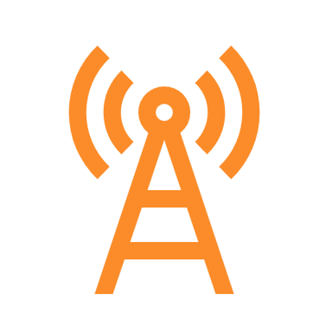
Mobile/cell phones
Cellular telephones are radios. They transmit radio signals back and forth to a cell site to make phone calls, send text messages, or data for applications. As you change location, the radio is transferred to another cell site along your way of travel. For the system to work, the cell sites are connected by landline cables. This makes them vulnerable in disasters, as these landlines can fail, and power can be lost. Battery life can fluctuate based on usage.

Slide 32
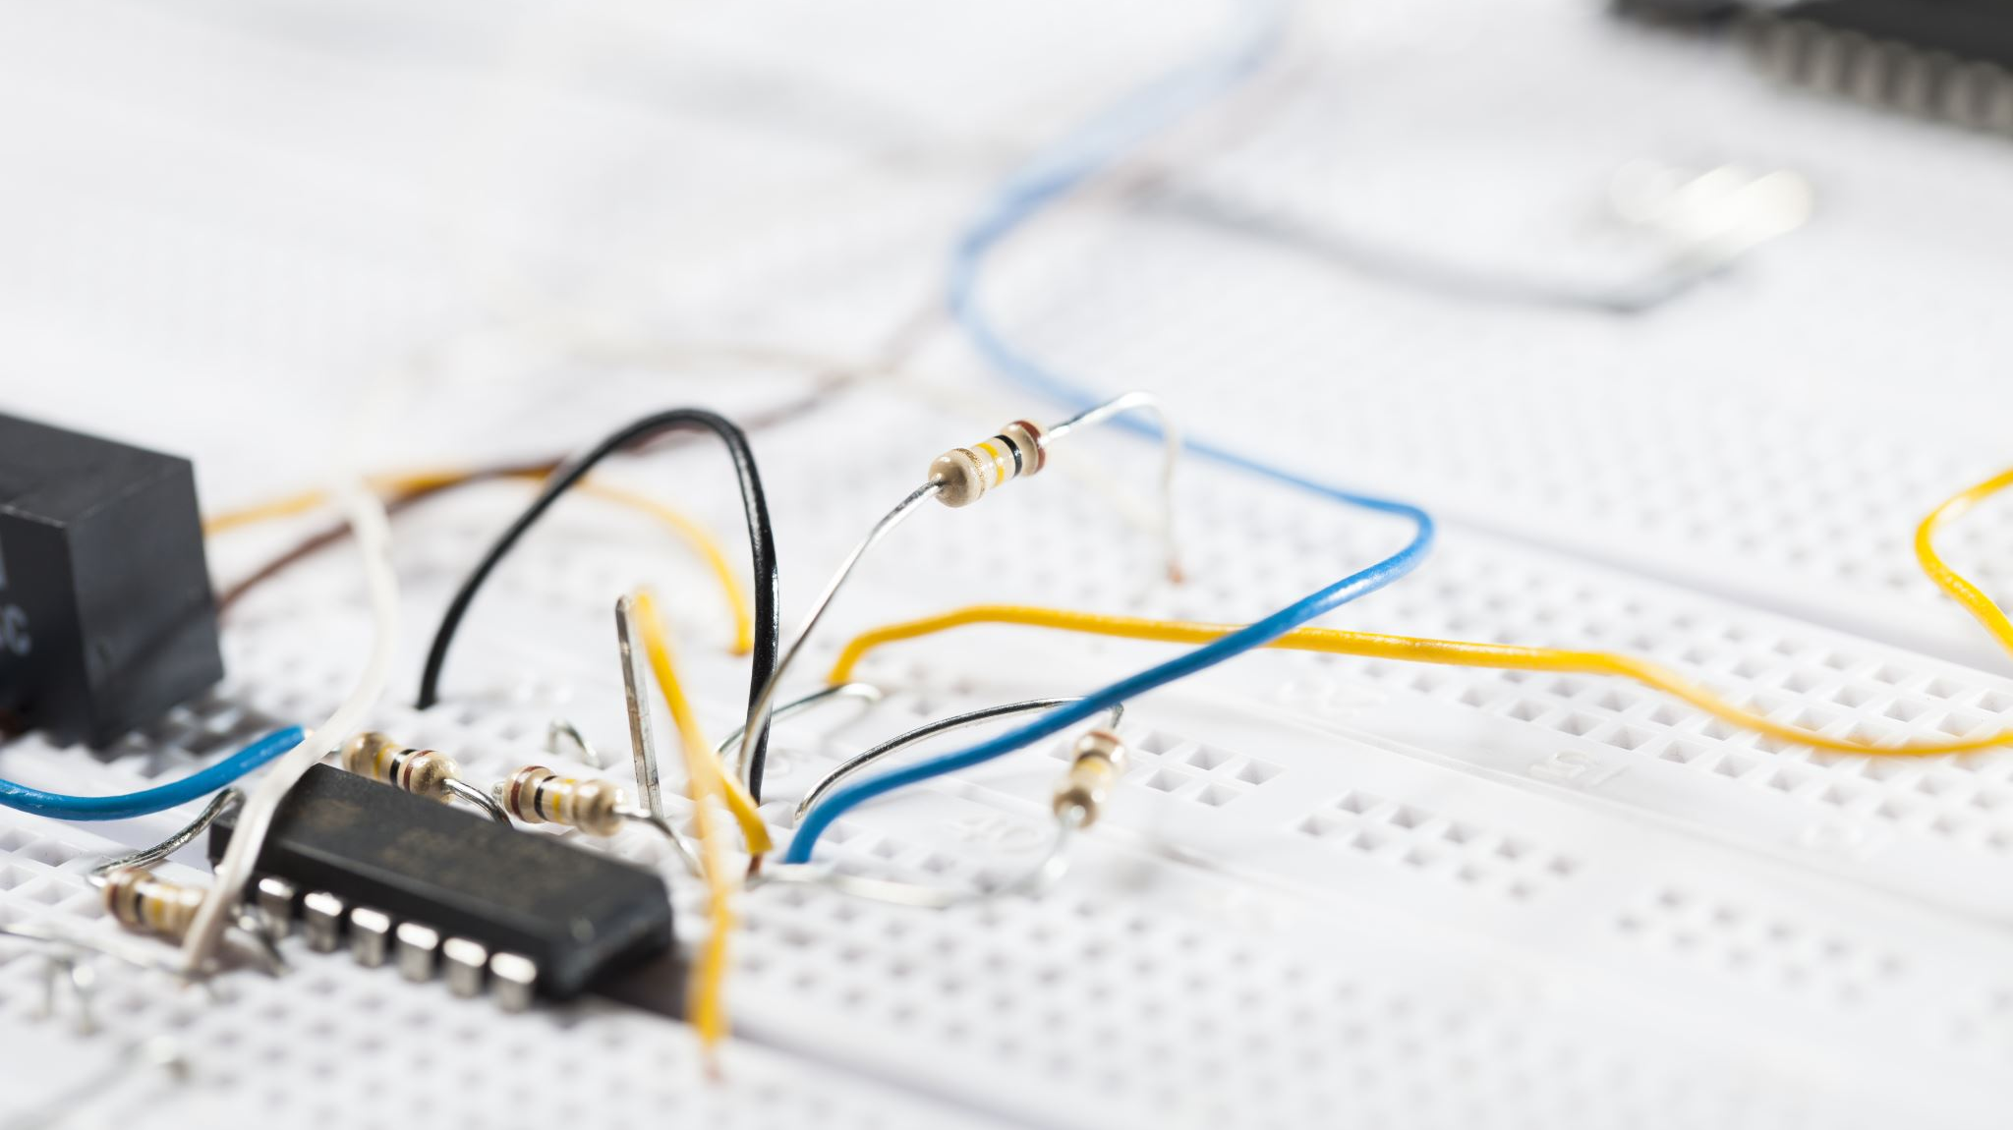
Requirement: 6
Explain the safety precautions for working with radio gear, including the concept of grounding for direct current circuits, power outlets, and antenna systems.

Slide 33
Safety Precautions
Electrical shock can hurt or kill - make sure the power is disconnected before working.
Even with the power off, some parts inside the radio can hold a dangerous charge. If you don't know what you are doing, get help.
Radio Frequency (RF) can burn - keep antennas out of reach .
Strong RF radiation can be unhealthy - Don't use a radio when it is not completely assembled. The case keeps the RF radiation where it should be.
Make sure antennas can't touch any power lines or you could be electrocuted when using the radio.
Lightning can hit your antenna and travel down your lines to the radio. Make sure your antenna and radio are grounded to a good earth ground.
Be careful working on towers and roofs so you don't fall or drop something onto someone on the ground.

Slide 34
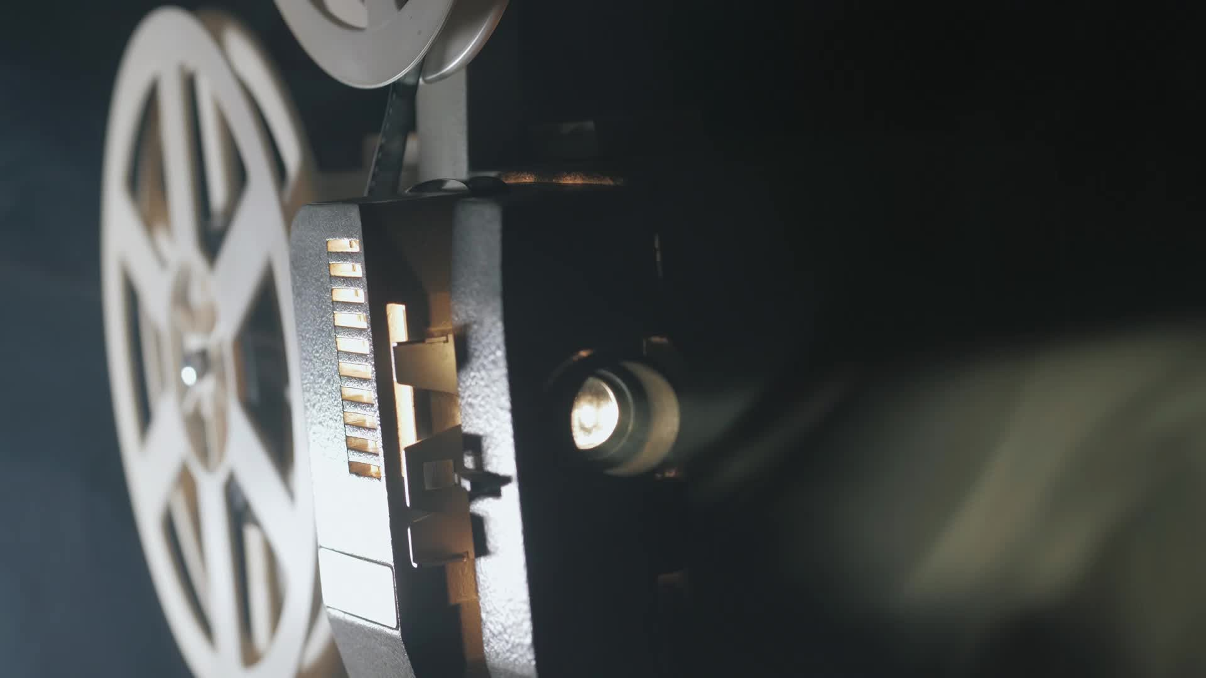
Requirement: 7
Visit a radio installation (an amateur radio station, broadcast station, or public service communications center, for example) approved in advance by your counselor. Discuss what types of equipment you saw in use, how it was used, what types of licenses are required to operate and maintain the equipment, and the purpose of the station.

Slide 35
Requirement: 8
Find out about three career opportunities in radio. Pick one and find out the education, training and experience required for this profession. Discuss this with your counselor, and explain why this profession might interest you.

Slide 36
Sample Radio Careers
Radio Personality
Board Operator
News Reporter
Broadcast Technician
Music Director
Station Manager
Sound Engineer
Promotions Director
Chief Engineer
Repair Technician
Satellite Technician
Point to Point Facilitator
Frequency Auditor
Disaster Relief
Emergency Dispatcher
Commercial Dispatcher
Air Traffic Control
Harbor Master

Slide 37
Requirement: 9
Do ONE of the following (a OR b OR c OR d):
(a) Amatuer Radio
(1) Tell why the FCC has an amateur radio service. Describe activities that amateur radio operators can do on the air, once they have earned an amateur radio license.
(2) Explain differences between the Technician, General, and Extra Class license requirements and privileges. Explain who administers amateur radio exams.
(3) Explain at least five Q signals or amateur radio terms.
(4) Explain how you would make an emergency call on voice or Morse code.
(5) Explain the differences between handheld transceivers and home "base" transceivers. Explain the uses of mobile amateur radio transceivers and amateur radio repeaters.
(6) Using proper call signs, Q signals, and abbreviations, carry on a 10-minute real or simulated amateur radio contact using voice, Morse code, or digital

Slide 38
Amateur Radio
Amateur Radio is a hobby where people help others, learn about radio and have fun. It's called Amateur Radio because the frequencies can't be used for commercial (money-making) purposes. It's also called "Ham Radio"
The FCC has an Amateur Radio Service for:
Volunteer service - (community service and disaster help). A Scout does a good turn daily - here's another way.
International goodwill - A great way to talk to people in far away lands.
Experimentation - If you want, you can build your own radio equipment, and many hams build their own antennas. Some hams have come up with new inventions, such as FM, SSB, Packet Radio, Automatic Position Reporting Systems.
Communication skills - Because only one person can talk at a time, you learn how to listen!
Self-training - You can learn by doing.

Slide 39
Amateur Radio
Jamboree On The Air (JOTA) is the third weekend every October when Scouts all over the world talk to each other on ham radio.
DX - Lots of hams like to talk to other hams around the world and collect postcards called QSL cards to prove they did it. It's a great way to have fun and learn about geography.
Contests are held many weekends when you try to contact as many people from a certain place or in a certain way.
Public Service at parades & special events - Ham radio operators are often the best people to help with communication at large community events, from small carnivals all the way up to the Boston and New York City Marathons.
Disasters - Hams are often called on to help during fires, floods, earthquakes, and other disasters. At these times, telephone lines and cell phone sites are often damaged or overloaded, and ham radio is the only reliable communication.
Skywarn - National Weather Service uses Hams to report severe weather.
Digital Communications - Some hams hook their computers to their radios so they can send electronic messages, sort of like wireless e-mail.
Camping communications are easy even in the backcountry when you need to get help or just let the folks back home know how things are going.

Slide 40
Technician, general, and extra class
The Technician Class license is the entry level Amateur Radio license.
This license gives full VHF & UHF use so you can communicate around town and use repeaters, but you cannot use some of the HF bands which are used for world-wide contacts.
The General Class license is the mid level Amateur Radio license. You must pass the Technician Class test first or at the same time..
This license adds most HF band privileges used for world-wide contacts to the VHF & UHF privileges previously earned.
The Extra Class license is the highest-level Amateur Radio license. You must pass the Technician Class test and the General Class test first or at the same time.
This license adds all privileges on all amateur bands.
ALL exams are given by local Volunteer Examiners

Slide 41
Q-Codes
Q Signals are three letter shortcuts used in Morse Code and useful when radio operators don't speak the same language. Here are the most common:
QTH: location
QSO: a Conversation
QSL: I acknowledge receipt
QSY: Change frequency
QRM; Manmade Interference
QRN: Noise
QRP: Low Power
QRT: Stopping Transmitting
CW: Morse Code (comes from Continuous Wave)
DX: Long distance
Ham: An Amateur Radio Operator
Phone: Voice transmissions
RTTY: Radio Teletype
Rig: My radio
Shack: my radio room
Signal Reports on Voice are given as:
RS (Readability, Strength); 59 is the best.

Slide 42
Emergency Calls on the radio
On voice, say
On Morse Code, send
Mayday, Mayday, Mayday
Your callsign
Your location
What help you need
Over
SOS SOS SOS
Your callsign
Your location
What help you need
AR

Slide 43
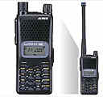
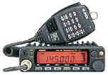
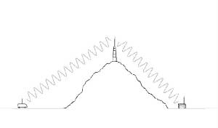
Amateur Radio Types
Handheld transceiver (HT): Small, light, portable, but not much power. Some can fit in your pocket. With repeaters they can be quite useful, and they can go on your hike easily.
Base station transceiver: Permanent station in a building. More power, easier to use, more features.
Mobile transceiver: Permanent station in a vehicle. More power. That HT antenna doesn't work well inside a metal car.
Repeaters: Located on high points (Mountains, tall buildings, satellites) to automatically relay signals. Some have connections to the telephone system.

Slide 44
10-minute Radio conversation
Q-Codes
Log-Book
QTH: location
QSO: a Conversation
QSL: I acknowledge receipt
QSY: Change frequency
QRM; Manmade Interference
QRN: Noise
QRP: Low Power
QRT: Stopping Transmitting
Date:
Time:
Frequency:
DX Callsign:
DX Name:
DX Location:
DX Signal Report (RST):
My Signal Report (RST):

Slide 45
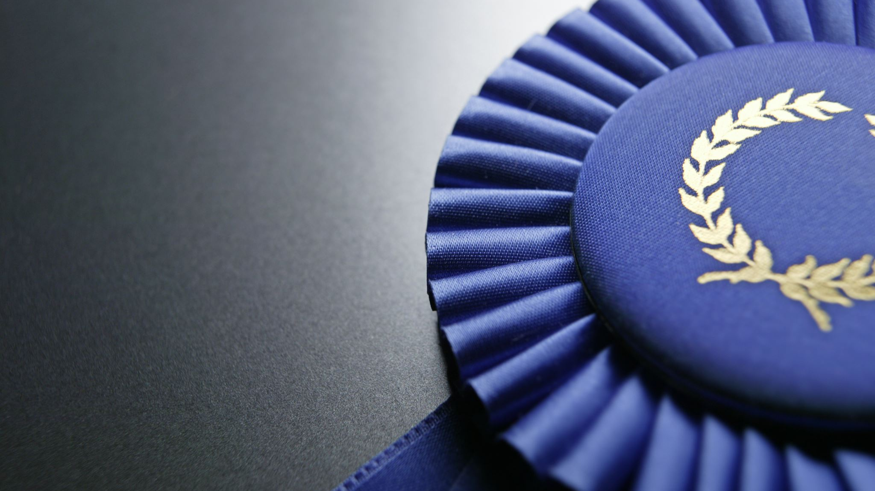
We’re done!
Congratulations for getting your newest Merit Badge!

