Slide 1
Electricity Merit Badge
Presented by: Shane McCracken
Troop 229
Independence, MO

Slide 2
Requirement: 1
Demonstrate that you know how to respond to electrical emergencies by doing the following:
(a) Show how to rescue a person touching a live wire in the home.
(b) Show how to render first aid to a person who is unconscious from electrical shock.
(c) Show how to treat an electrical burn.
(d) Explain what to do in an electrical storm.
(e) Explain what to do in the event of an electrical fire.

Slide 3
Live Wire Rescue
Rescuing someone touching a live wire at home needs to be done with extreme caution to ensure everyone’s safety. Here’s a straightforward guide:
Don’t Touch: The first rule is, don’t touch the person or the wire with your bare hands. Electricity can travel through your body and cause harm. Stay at least 20 feet away from the wire if possible.
Call for Help: Immediately call 911 or your local emergency number. Tell them there’s a person in contact with a live wire. Provide your address and any other information they ask for.
Cut the Power: If it’s safe to do so, cut off the electrical power. Locate the circuit breaker box or fuse box in your home and turn off the circuit that supplies power to the area where the person is in contact with the wire. Use a non-conductive object, like a wooden stick, to flip the switch or pull the fuse.
Use a Non-Conductive Aid: If you can’t reach the circuit breaker safely, try to use a non-conductive object, like a dry wooden broom or PVC pipe, to gently push or pull the person away from the wire. Do not touch them directly.
Wait for Professionals: Even if you manage to move the person away from the wire, they might still be at risk of electrical shock. Keep a safe distance until paramedics or firefighters arrive. They are trained to handle such situations safely.
Remember, the key is to prioritize safety! Don’t take unnecessary risks, and leave the actual rescue to professionals whenever possible.

Slide 4
Electrical Shock
Providing first aid to an unconscious person from electrical shock requires caution and immediate action. Here’s a straightforward guide:
Ensure Safety: Before approaching the person, make sure the electrical source is turned off or the person is no longer in contact with it. Your safety is a priority.
Call for Help: Dial 911 or your local emergency number immediately to summon professional medical assistance. Report that you’re dealing with an unconscious person from electrical shock.
Check for Breathing and Pulse: Approach the person cautiously, avoiding any contact with the electrical source. Check if they are breathing and have a pulse. If they aren’t breathing or have no pulse, you may need to perform CPR. If you’re trained in CPR, begin chest compressions and rescue breaths. If not, follow the dispatcher’s instructions until help arrives.
Keep Them Still: If the person has a pulse and is breathing, keep them still and in a comfortable position. Do not move them unless it’s necessary for their safety.
Monitor Vital Signs: Keep an eye on the person’s breathing and pulse while waiting for professional help. Be prepared to perform CPR if their condition worsens.
Do Not Offer Food or Water: Avoid giving the person food or water, as they may have internal injuries.
Offer Comfort: Talk to the person calmly to reassure them that help is on the way. Stay with them until medical professionals arrive.
Remember, electrical shock can cause hidden injuries, so it’s crucial to seek immediate medical attention even if the person appears stable. Your primary role is to ensure their safety, provide basic care, and wait for professional help to take over.

Slide 5
Electrical Burns
Ensure Safety: Before helping the person, make sure the electrical source is turned off or the person is no longer in contact with it. Your safety is important.
Call for Help: Dial 911 or your local emergency number to get professional medical assistance. Electrical burns can be serious, and it’s crucial to have them evaluated by a healthcare provider.
Assess the Burn: Examine the burn and determine its severity. Electrical burns can vary from mild to severe. If the burn is severe (deep, covers a large area, or involves the head, hands, feet, genitals, or major joints), do not attempt to treat it beyond keeping it clean and covered.
Cool the Burn: If the burn is minor and the person is not allergic to cold, gently cool the burn with cool (not cold) running water for about 10-20 minutes. Avoid using ice or very cold water as it can damage the tissue further.
Protect the Burn: Cover the burn with a sterile, non-stick dressing or a clean, dry cloth to prevent infection. Do not use adhesive bandages directly on the burn.
Elevate if Possible: If the burn is on an extremity (arm or leg) and the person can tolerate it, elevate the injured area slightly to reduce swelling.
Do Not Pop Blisters: If blisters form, do not pop them, as this can increase the risk of infection.
Monitor for Shock: Keep a close eye on the person for signs of shock, such as rapid breathing, confusion, or pale and clammy skin. If you notice these signs, lay the person down, keep them warm, and elevate their legs if possible while waiting for professional help.
Remember, electrical burns can be more serious than they appear, and professional medical evaluation is crucial. Your role is to provide initial care, keep the burn clean and covered, and call for professional help.

Slide 6
Electrical Storms
Stay Indoors: The safest place to be during an electrical storm is indoors. Seek shelter in a sturdy building. Avoid small, open structures like gazebos and picnic shelters as they don’t provide adequate protection.
Avoid Electrical Appliances: Unplug sensitive electronic devices like computers and televisions. Lightning strikes can cause power surges that damage electronics. Stay away from corded phones and don’t use them during the storm.
Stay Away from Water: Don’t take a bath, shower, or use sinks and faucets during an electrical storm. Lightning can travel through plumbing.
Stay Away from Windows: Lightning can strike windows, so stay away from them. Close curtains or blinds to prevent shattered glass if lightning does strike.
Don’t Go Outside: Avoid going outdoors during an electrical storm, even if it seems like a short break in the rain. Lightning can strike from a distance.
Stay Informed: Listen to a battery-powered weather radio or use a weather app on your phone to stay updated about the storm’s progress and when it’s safe to go outside.
If You’re Caught Outside: If you’re caught outside with no shelter nearby, avoid tall objects and open fields. Don’t take shelter under trees, as they can attract lightning. Crouch low and make yourself as small a target as possible.
Wait for the All-Clear: Wait at least 30 minutes after the last clap of thunder before going back outside. Lightning can strike even after the rain stops.
Help Others: If you see someone struck by lightning, call 911 immediately and provide first aid if you’re trained to do so.
Remember, electrical storms are dangerous, and it’s crucial to prioritize safety. Staying indoors and away from electrical appliances and water is the best way to protect yourself during a storm.

Slide 7
Electrical Fire
Safety First: Your safety is the top priority. If the fire is small and can be easily managed, and you have a suitable fire extinguisher, you can try to use it to put out the fire. However, if the fire is spreading rapidly or you’re unsure about using a fire extinguisher, evacuate immediately.
Call 911: Dial 911 or your local emergency number to report the fire. Even if you think you’ve extinguished it, it’s essential to have professionals on the way in case the fire reignites or there’s hidden damage.
Evacuate: If the fire is not easily controllable, evacuate the building immediately. Make sure everyone else in the building is aware of the fire and is also evacuating. Do not use elevators during a fire; use the stairs.
Close Doors: As you leave, close any doors behind you. This can help contain the fire and slow its spread.
Do Not Use Water: Do not attempt to extinguish an electrical fire with water. Water can conduct electricity and make the situation worse. Use a fire extinguisher rated for electrical fires if available.
Turn Off Power: If it’s safe to do so and you can reach the circuit breaker or fuse box without risking injury, turn off the power supply to the affected area. This can help prevent the fire from getting worse.
Stay Low: If there’s smoke, stay close to the ground as smoke rises, and the air near the floor is less smoky and toxic.
Don’t Re-enter: Once you’ve evacuated, do not re-enter the building until the fire department gives the all-clear.
Remember, electrical fires can be particularly hazardous due to the risk of electric shock. Prioritize safety, call for professional help, and evacuate if you’re not confident in your ability to extinguish the fire safely.

Slide 8
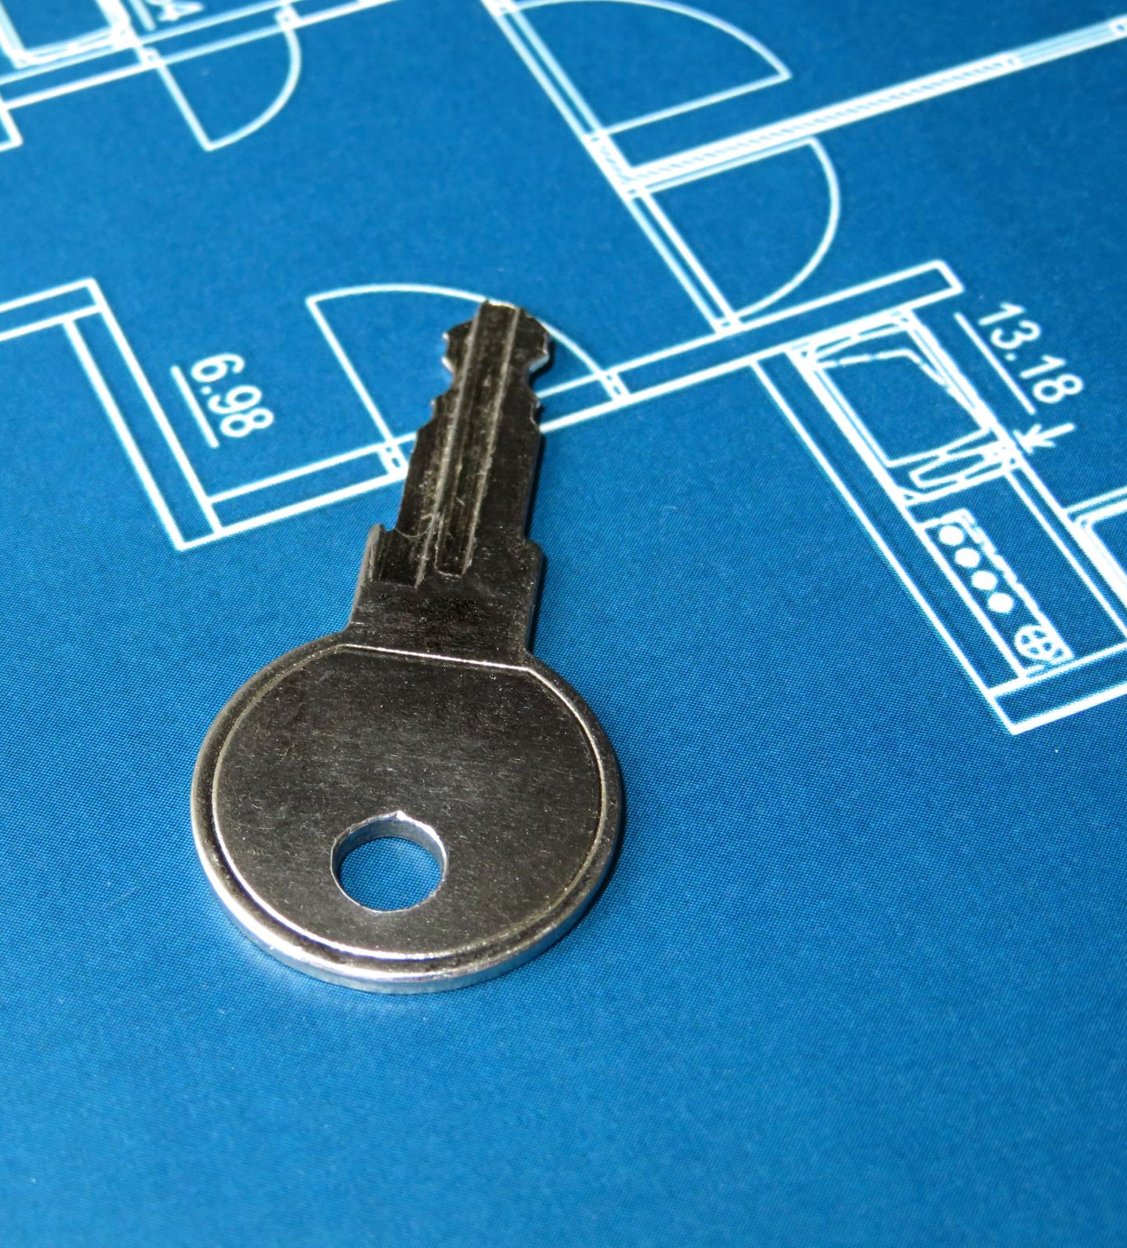
Requirement 2:
Complete an electrical home safety inspection of your home, using the checklist found in the Electricity merit badge pamphlet or one approved by your counselor. Discuss what you find with your counselor.

Slide 9
Requirement: 2
Download a printable copy of the Electrical Home Safety Inspection Checklist
Remember, safety is the primary concern when inspecting your home’s electrical system. If you discover any issues or are unsure about any aspect of the inspection, seek professional assistance to address and resolve the problems.

Slide 10
Requirement: 3
Make a simple electromagnet and use it to show magnetic attraction and repulsion.
Activity time!

Slide 11
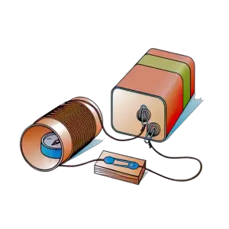
Making a simple electromagnet
Materials You Need:
A pen or a pencil to wrap wire around
Insulated (plastic-coated) wire
A 4.5-volt or 6-volt battery

Slide 12
Steps to Make the Electromagnet:
Wrap the Wire: Take the insulated wire and wrap it around the pen or pencil.
Connect the Battery: Attach one end of the wire to the positive (+) side of the battery and the other end to one side of the switch. Then, connect a wire from the other side of the switch to the negative (-) side of the battery.
Place the Compass: Use your new electromagnet! (Tip: find the poles of your magnet by using a compass!)
Remember, be careful when working with batteries and wires, and don’t leave the battery connected for too long, as it can get hot. Have fun experimenting with your electromagnet!

Slide 13
Requirement: 4
Explain the difference between direct current and alternating current.

Slide 14
The difference between direct current (DC) and alternating current (AC)s:
Direct Current (DC):
Alternating Current (AC):
DC flows steadily in one direction, like water flowing in a straight pipe.
It’s like a battery in your flashlight, where the electric current always goes from the positive (+) end to the negative (-) end.
DC is simple and easy to understand but may not travel long distances efficiently.
AC constantly changes direction, like a swinging pendulum.
It’s the type of electricity that powers most of our homes and devices.
AC changes direction many times per second (measured in Hertz, or Hz), typically 60 times per second in the U.S.
AC is more efficient for long-distance transmission because it can be easily transformed into higher or lower voltages.

Slide 15
Simply Put….
Think of DC as a straight path for electricity, like a one-way street, while AC is like a winding road that switches directions, but it’s better for delivering electricity over long distances. Both types have their uses in different situations, but AC is more common in our daily lives.

Slide 16
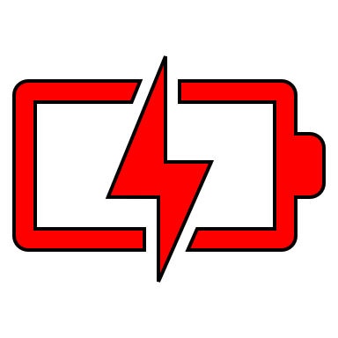
Requirement: 5
Make a simple drawing to show how a battery and an electric bell work.

Slide 17
Battery and Bell Drawing
The diagram presents an electric vibrating bell setup. To understand its functionality, let’s follow the path of the electric current:
Pushing the button allows current to flow from terminal A to the electromagnet, labeled F.
The current then travels to a moving contact, C, and proceeds to contact post D, finally exiting through terminal E.
Now, how does this current make the bell ring?
As you press the button, electromagnet F attracts an iron armature, labeled B.
This armature has two attachments: the moving contact C and a hammer, H.
The hammer strikes a gong or bell, producing the ringing sound.
As the armature is drawn towards the magnet, the contact C is pulled away from post D, breaking the circuit and cutting off the current.
When the current stops, the electromagnet loses its magnetic force. A return spring, G, then pulls the armature and contact C back towards post D.
Once contact C reestablishes connection with post D, the current flows again, and the cycle repeats. This rapid repetition creates the continuous ringing or vibrating sound.

Slide 18
Requirement: 6
Explain why a fuse blows or a circuit breaker trips. Tell how to find a blown fuse or tripped circuit breaker in your home. Show how to safely reset the circuit breaker.

Slide 19
Why a Fuse Blows or a Circuit Breaker Trips
A fuse blows or a circuit breaker trips to protect your home’s electrical system from problems. It happens when there’s too much electricity flowing through a circuit, which can be dangerous. This can occur if there are too many devices plugged in or if there’s a short circuit (a wire touching something it shouldn’t). The fuse or breaker acts like a safety switch to stop the flow of electricity and prevent fires or damage.

Slide 20
Finding a Blown Fuse or Tripped Circuit Breaker
To find a blown fuse or a tripped circuit breaker in your home, follow these steps:
First, if the lights go out or something stops working, unplug any devices from that circuit to be safe.
Check your home’s fuse box or circuit breaker panel. It’s usually in the basement, garage, or utility room.
Look for a fuse that has a broken wire inside or a circuit breaker that’s in the “off” position. These are the signs of a blown fuse or tripped breaker.

Slide 21
Safely Resetting the Circuit Breaker
If you have a tripped circuit breaker, you can safely reset it:
First, unplug the devices on that circuit.
Find the circuit breaker that’s in the “off” position.
Push the breaker switch all the way to the “off” position and then back to the “on” position. You should hear a click.
Now, plug your devices back in one by one to make sure everything’s working.

Slide 22
Remember!!!
It’s important to be safe and not overload your circuits. If a fuse keeps blowing or a circuit breaker keeps tripping, it’s a sign of a problem, and you may need an electrician to check it out.

Slide 23
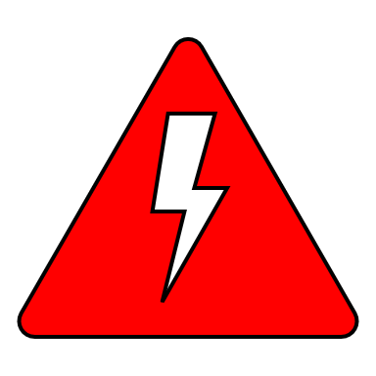
Requirement 7:
Explain what overloading an electric circuit means. Tell what you have done to make sure your home circuits are not overloaded.

Slide 24
What Overloading an Electric Circuit Means
Overloading an electric circuit means putting too much demand on it. It’s like trying to carry too many heavy bags at once; if you add too much, you might drop everything. In electrical terms, it happens when you connect too many devices or appliances to a single circuit, and it can lead to problems like blown fuses or tripped circuit breakers.

Slide 25
How to Prevent Overloading Your Home Circuits
Know Your Circuit’s Limit: Understand how much electricity each circuit in your home can handle. You can usually find this information on the circuit breaker panel.
Balance the Load: Spread your devices and appliances across different circuits. Don’t plug too many high-power devices (like heaters or air conditioners) into one circuit.
Use Power Strips Wisely: Power strips with surge protection can help, but don’t overload them either. Avoid daisy-chaining multiple power strips together.
Unplug Unused Devices: When you’re not using something, unplug it. Even when turned off, some devices still use a small amount of electricity.
Consider Upgrades: If you frequently have overloading issues, consider adding more circuits or upgrading your electrical system with the help of an electrician.

Slide 26
Requirement: 8
Make a floor plan wiring diagram of the lights, switches, and outlets for a room in your home. Show which fuse or circuit breaker protects each one.

Slide 27
Tips for Drawing a Wiring Diagram
Pick a Room: Choose a room in your home to create the diagram for. It’s best to start with a smaller room like a bedroom or living room.
Draw the Walls: Start by drawing the outline of the room, including walls, doors, and windows. Make it simple; you don’t need to be an artist.
Label the Outlets and Switches: Mark where all the electrical outlets (where you plug things in) and light switches are located on your drawing. Use clear labels like “Outlet 1” and “Switch A.”
Show the Lights: Draw symbols or simple shapes to represent the lights in the room. Label them clearly as “Light 1,” “Light 2,” and so on.
Draw Lines: Use lines to connect the outlets, switches, and lights to show how they’re connected. Use different line styles or colors to indicate which circuit they are on.
Label the Fuses or Circuit Breakers: For each circuit, write down which fuse or circuit breaker in your electrical panel protects it. This is usually marked on the panel itself.
Keep It Neat: Make sure your diagram is easy to read. Use a ruler to draw straight lines and keep your labels neat and legible.
Double-Check: Review your diagram to ensure you haven’t missed anything. Make sure every outlet, switch, and light is accounted for.

Slide 28
Remember!!!!
The goal is to create a clear and accurate diagram of the electrical wiring in your chosen room. Keep it simple and organized, and you’ll successfully complete Electricity merit badge requirement 8!!!

Slide 29
Requirement: 9
Do the following:
(a) Read an electric meter and, using your family's electric bill, determine the energy cost from the meter readings.
(b) Discuss with your counselor five ways in which your family can conserve energy.

Slide 30
Tips for Reading an Electric Meter and Determining Energy Cost
Locate the Electric Meter: Find the electric meter on the outside of your home. It looks like a box with numbers on it, usually near the entrance.
Read the Numbers: The numbers on the meter represent how much electricity you’ve used. Start from left to right, and write down the numbers in order.
Note the Units: Check your electric meter to see what units it uses. It could be in kilowatt-hours (kWh) or something similar.
Check the Date: Look at the date on your electric bill to know the billing period. It’s usually for a month.
Calculate the Usage: Subtract the previous month’s reading (found on your last bill) from the current reading to find out how many units you’ve used during the billing period.
Find the Rate: Check your electric bill to see how much you’re charged per unit (kWh). It’s often listed as the “electricity rate.”
Multiply for Cost: Multiply the units you’ve used by the rate per unit to calculate the energy cost for that billing period.
Double-Check: Make sure your calculations are correct, and it matches the amount on your electric bill. It’s essential to be accurate.
Learn About Usage Patterns: Take this opportunity to understand your family’s electricity usage habits. See if there are ways to reduce energy consumption to save money and be more energy-efficient.

Slide 31
Ways to Conserve Energy
Turn Off Lights: Always turn off lights in rooms that are not in use.
Use Energy-Efficient Bulbs: Replace old bulbs with energy-saving LED or CFL bulbs.
Unplug Devices: Unplug chargers, electronics, and appliances when they’re not in use to avoid “phantom” energy use.
Seal Leaks: Seal gaps around doors and windows to prevent drafts that make your heating or cooling system work harder.
Set Thermostat Wisely: Adjust your thermostat to use less heating or cooling when you’re not at home or during the night.
Use Ceiling Fans: In warmer months, use ceiling fans to help cool rooms instead of lowering the thermostat.
Upgrade Appliances: Choose energy-efficient appliances when it’s time to replace old ones.
Wash Clothes Smartly: Use cold water for laundry, and line dry when possible.
Limit Hot Water Use: Take shorter showers and use a low-flow showerhead to reduce hot water consumption.
Plant Trees: Planting shade trees around your home can reduce cooling costs in the summer.

Slide 32
Ways to Conserve Energy
Maintain HVAC Systems: Regularly service your heating and cooling systems to keep them running efficiently.
Cook Efficiently: Use lids on pots, match the pot size to the burner, and cook with the lid on to retain heat.
Use Natural Light: Open curtains during the day to use natural light instead of artificial lighting.
Install a Programmable Thermostat: A programmable thermostat can automatically adjust the temperature when you’re not home.
Insulate Your Home: Proper insulation can make your home more energy-efficient.
Educate Your Family: Teach everyone in your family about the importance of conserving energy, and involve them in energy-saving efforts.
By following these tips, your family can reduce energy consumption, lower utility bills, and contribute to a more sustainable environment.

Slide 33
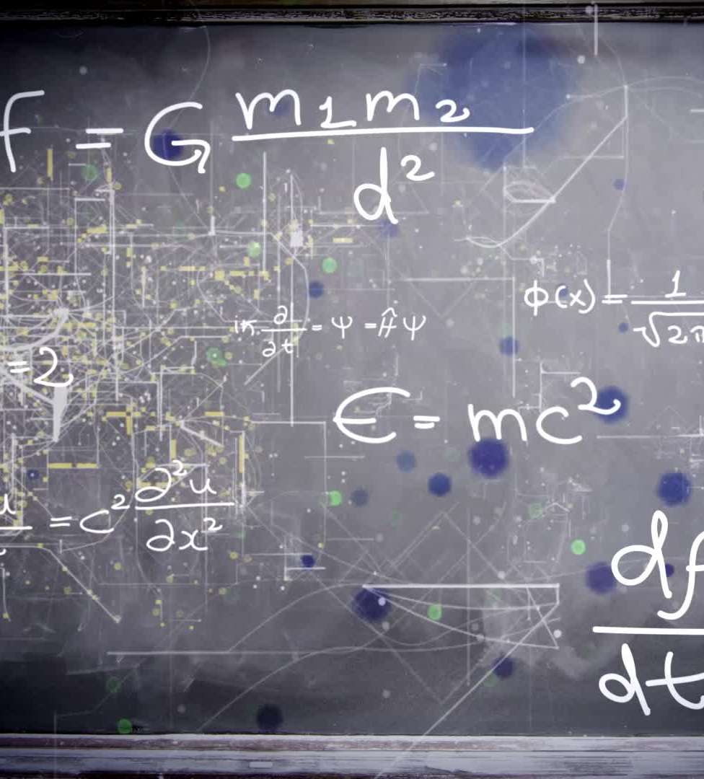
Requirement: 10
Explain the following electrical terms: volt, ampere, watt, ohm, resistance, potential difference, rectifier, rheostat, conductor, ground, GFCI, circuit, and short circuit.

Slide 34
Electrical Terms
Volt: Volts measure electrical force. Think of volts as the “push” that makes electricity flow. It’s like the force that pushes water through a hose.
Ampere (Amp): Ampere measures how much electricity is flowing in a circuit. It’s like counting how many gallons of water flow through the hose each minute.
Watt: Watt tells you how much energy an appliance uses or produces. It’s like knowing how bright a light bulb is or how powerful a motor is.
Ohm: Ohm is a measure of resistance in a circuit. It’s like the width of a pipe; a narrow pipe has more resistance, making water flow slower.
Resistance: This is how much a material resists the flow of electricity. Think of it like a narrow road that slows down traffic.

Slide 35
Electrical Terms
Potential Difference (Voltage): It’s the voltage between two points in a circuit. It’s like the difference in height between two water tanks that determines how fast water will flow from one to the other.
Rectifier: A rectifier turns alternating current (AC) into direct current (DC). It’s like changing the flow of a river from back-and-forth to one-way.
Rheostat: A rheostat is a variable resistor, like a dimmer switch for lights. It controls the flow of electricity, making it stronger or weaker.
Conductor: This is a material that allows electricity to flow easily, like a metal wire.

Slide 36
Electrical Terms
Ground: Ground is like a safety net for electricity. It provides a safe path for extra electricity to go if there’s a problem.
GFCI (Ground Fault Circuit Interrupter): It’s like a safety guard for your outlets. It shuts off the power if it senses an electrical problem, like a short circuit.
Circuit: A circuit is like a pathway for electricity to travel. It usually includes wires, devices, and a power source.
Short Circuit: A short circuit happens when electricity takes a shortcut in a circuit, often causing sparks or fires. It’s like water spilling over the edge of a bucket instead of flowing through a hose.

Slide 37
Requirement: 11
Do any TWO of the following:
(a) Connect a buzzer, bell, or light with a battery. Have a key or switch in the line.
(b) Make and run a simple electric motor (not from a kit).
(c) Build a simple rheostat. Show that it works.
(d) Build a single-pole, double-throw switch. Show that it works.
(e) Hook a model electric train layout to a house circuit. Tell how it works.

Slide 38
Activities
11b: Making and Running a Simple Electric Motor
11d: Building a Single-Pole, Double-Throw Switch

Slide 39
We’re Done!
Thank you and congratulations on your new merit badge!

